Slide 1
EECS 2500 Linear Data Structures
Lecture 04
Chapter 02 – Abstract Data Types – Part 1
Fall 2016
Dr. Larry G. Thomas – University of Toledo/LCCC

Slide 2
Last Time
Basic Structuring Mechanisms (1.6)
References
Aliasing
Arrays (reference variables)
Garbage
Garbage collection
Algorithm Analysis
Big-O Analysis: highest-order term; discard constants
Orders of Magnitude: Constant (bounded), Logarithmic, Linear, N lg N, Quadratic, Exponential
Best, Average, Worst-case complexity
Multiple algorithms to solve the same problem

Slide 3
Chapter 2 – Abstract Data Types (ADT)
2.1: Abstraction
2.2: The StringLog ADT Specification
2.3: Array-based StringLog Implementation
2.4: Software Testing
2.5: Introduction to Linked Lists
2.6: Linked List StringLog ADT Implementation
2.7: Software Design: Identification of Classes
2.8: Case Study: A Trivia Game

Slide 4
Abstraction
Section 2.1

Slide 5
2.1: Abstraction
Abstraction: A (simplifying) model of a system that includes only the details essential to the perspective of the viewer of the system
“The devil is in the details”
Don’t sweat the small stuff
The viewer of the system is on a need-to-know basis
Information hiding: The practice of hiding details within a module with the goal of controlling access to the details from the rest of the system
Details are only important locally (e.g., square root)

Slide 6
2.1: Abstraction
Data abstraction: The separation of a data type’s logical properties from its implementation
You don’t need to know the details of how a data type works; you just need to know how to use it
Big-endian / little-endian architecture
Abstract data type (ADT): A data type whose properties (domain and operations) are specified independently of any particular implementation
Domain: The set of all possible values
Operations: The operations available to manipulate the values

Slide 7
ADT Perspectives or Levels
We deal with ADTs from three different perspectives
Application- (or user- or client-) level
Logical- (or abstract-) level
Implementation- (or concrete-) level

Slide 8
ADT Perspectives or Levels
Application (or user or client) level: We use the ADT to solve a problem. When working at this level we only need to know how to create instances of the ADT and invoke its operations.
How to use it; not how it works
Screwdriver – We pick it up and use it to turn a screw
We don’t consider torque, or all of the potential head sizes and shapes, or the hardness of the steel used to make it, or the kind of plastic used in the handle; we just use the appropriate one to solve the problem at hand

Slide 9
ADT Perspectives or Levels
Logical (or abstract) level: Provides an abstract view of the data values (the domain) and the set of operations to manipulate them. At this level, we deal with the “what” questions.
What is the ADT?
What does it model?
What are its responsibilities?
What is its interface?

Slide 10
ADT Perspectives or Levels
Implementation (or concrete) level: Provides a specific representation of the structure to hold the data and the implementation of the operations. Here we deal with the “how” questions.
How it works (how the methods do what they do)
How the data is stored and represented

Slide 11
Pre- and Post-Conditions
Preconditions: Assumptions that must be true on entry into a method for it to work correctly
Square root function assumes its argument is ≥ 0
A lookup module in a database program may assume the user has already entered a valid ID/Password
Prerequisite for a class
Postconditions or Effects: The results expected at the exit of a method, assuming that the preconditions are true before the method call
We specify pre- and postconditions for a method in a comment at the beginning of the method

Slide 12
Pre- and Post-Conditions
In effect, specifying the pre- and post-conditions creates a contract between the programmer of an ADT and the user of the ADT
The programmer certifies that, as long as the pre-conditions are met, the module will take its input and produce the appropriate effect, output, or post-condition
Documenting the assumptions helps with development and debugging

Slide 13
Java: Abstract Method
Only includes a description of its parameters
In C/C++, it’s a “Function Prototype”
No method bodies or implementations are allowed.
In other words, only the interface of the (single) method is included.
“Three-prong 110 Volt AC Outlet” is an interface
I don’t care who built the outlet
I don’t care what it’s made out of
I don’t care whether the wire is solid or stranded
I just need to know that my cord will plug into that socket, and that it will deliver 110 volts AC.

Slide 14
Java: Interfaces
Similar to a Java class
can include variable declarations
can include methods
However
Variables must be constants (final)
Methods must be abstract (no code)
A Java interface cannot be instantiated.

Slide 15
Java: Interfaces
We can use an interface to formally specify the logical level of an ADT:
It provides a template for classes to fill.
A separate class then "implements" it.
For example, see the FigureGeometry interface (next slide) and the Circle class that implements it (following slide)

Slide 16
Java: Interfaces
public interface FigureGeometry
{
final float PI = 3.14f;
float perimeter();
// Returns perimeter of this figure.
float area();
// Returns area of this figure.
void setScale(int scale);
// Scale of this figure is set to "scale".
float weight();
// Precondition: Scale of this figure has been set.
//
// Returns weight of this figure. Weight = area X scale.
}

Slide 17
Java: Interfaces
public class Circle implements FigureGeometry
{
protected float radius;
protected int scale;
public Circle(float radius)
{
this.radius = radius;
}
public float perimeter()
// Returns perimeter of this figure.
{
return(2 * PI * radius);
}
public float area()
// Returns area of this figure.
{
return(PI * radius * radius);
}
...
...
public void setScale(int scale)
// Scale of this figure is set to "scale".
{
this.scale = scale;
}
public float weight()
// Precondition: Scale of this figure has
// been set.
//
// Returns weight of this figure.
// Weight = area X scale.
{
return(this.area() * scale);
}
}

Slide 18
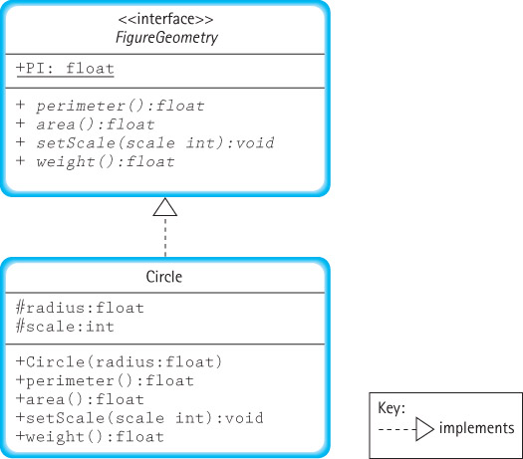
Interfaces and UML Diagrams

Slide 19
Benefits of Using Interfaces
We can formally check the syntax of our specification. When we compile the interface, the compiler uncovers any syntactical errors in the method interface definitions.
We can formally verify that the interface “contract” is met by the implementation. When we compile the implementation, the compiler ensures that the method names, parameters, and return types match what was defined in the interface.
We can provide a consistent interface to applications from among alternate implementations of the ADT.

Slide 20
The ADT StringLog Specification
Section 2.2

Slide 21
2.2: The StringLog Specification
The primary responsibility of the StringLog ADT is to remember all the strings that have been inserted into it and, when presented with any given String, indicate whether or not an identical string has already been inserted.
A StringLog client uses a StringLog to record strings and later check to see if a particular string has been recorded.
Every StringLog must have a “name”.

Slide 22
StringLog Methods
Constructors
A constructor creates a new instance of the ADT. It is up to the implementer of the StringLog to decide how many, and what kind, of constructors to provide.
Transformers (mutators)
insert(String element): assumes the StringLog is not full; adds element to the log of strings.
clear(): resets the StringLog to the empty state; the StringLog retains its name.

Slide 23
StringLog Methods
Observers (accessors)
contains(String element): returns true if element is in the StringLog, false otherwise; We ignore case when comparing the strings.
size(): returns the number of elements currently held in the StringLog.
isFull(): returns whether or not the StringLog is full (true if full; false if not).
getName(): returns the name attribute of the StringLog.
toString(): returns a nicely formatted string that represents the entire contents of the StringLog.

Slide 24
The StringLog Interface (1)
//---------------------------------------------------------------------
// StringLogInterface.java by Dale/Joyce/Weems Chapter 2
//
// Interface for a class that implements a log of Strings.
// A log "remembers" the elements placed into it.
//
// A log must have a "name".
//---------------------------------------------------------------------
package ch02.stringLogs;
public interface StringLogInterface
{
void insert(String element);
// Precondition: This StringLog is not full.
//
// Places element into this StringLog.
...

Slide 25
The StringLog Interface (2)
boolean isFull();
// Returns true if this StringLog is full, otherwise returns false.
int size();
// Returns the number of Strings in this StringLog.
boolean contains(String element);
// Returns true if element is in this StringLog, otherwise returns false.
// Ignores case differences when doing string comparison.
void clear();
// Makes this StringLog empty.
String getName();
// Returns the name of this StringLog.
String toString();
// Returns a nicely formatted string representing this StringLog.
}

Slide 26
Application Example
//----------------------------------------------------------------------
// UseStringLog.java by Dale/Joyce/Weems Chapter 2
//
// Simple example of the use of a StringLog.
//----------------------------------------------------------------------
import ch02.stringLogs.*;
public class UseStringLog
{
public static void main(String[] args)
{
StringLogInterface log;
log = new ArrayStringLog("Example Use");
log.insert("Elvis");
log.insert("King Louis XII");
log.insert("Captain Kirk");
System.out.println(log);
System.out.println("The size of the log is " + log.size());
System.out.println("Elvis is in the log: " + log.contains("Elvis"));
System.out.println("Santa is in the log: " + log.contains("Santa"));
}
}

Slide 27
Output From Example
Log: Example Use
1. Elvis
2. King Louis XII
3. Captain Kirk
The size of the log is 3
Elvis is in the log: true
Santa is in the log: false

Slide 28
Review: The Three Levels
(1) Application (or user or client) level: The UseStringLog program is the application. It declares a variable log of type StringLogInterface. It uses the ArrayStringLog implementation of the StringLogInterface to perform some simple tasks.
(2) Logical (or abstract) level: StringLogInterface provides an abstract view of the StringLog ADT. It is used by the UseStringLog application and implemented by the ArrayStringLog class.

Slide 29
Review: The Three Levels
(3) Implementation (or concrete) level: The ArrayStringLog class developed in Section 2.3 provides a specific implementation of the StringLog ADT, fulfilling the contract presented by the StringLogInterface. It is used by applications such as UseStringLog. Likewise, the LinkedStringLog class (see Section 2.6) also provides an implementation.

Slide 30
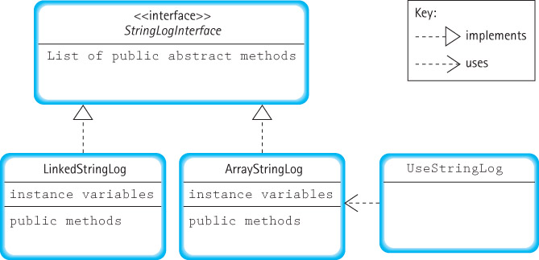
Relationships Among StringLog Classes

Slide 31
Implementing the StringLog (With an Array)
Section 2.3

Slide 32
2.3: Implementing StringLog (Array)
Class name: ArrayStringLog
Distinguishing feature: strings are stored sequentially, in adjacent slots in an array
Package: ch02.stringLogs (same as StringLogInterface)

Slide 33
Instance Variables
String[] log
The elements of a StringLog are stored in an array of String objects named log.
int lastIndex = -1
Originally the array is empty. Each time the insert method is invoked, another string is added to the array. We use this variable to track the index of the “last” string inserted into the array.
String name
Recall that every StringLog must have a name. We call the needed variable name.

Slide 34
Instance Variables and Constructors
package ch02.stringLogs;
public class ArrayStringLog implements StringLogInterface
{
protected String name; // name of this log
protected String[] log; // array that holds log strings
protected int lastIndex = -1; // index of last string in array
public ArrayStringLog(String name, int maxSize)
// Precondition: maxSize > 0
//
// Instantiates an empty StringLog object with name "name" and room for maxSize strings.
{
log = new String[maxSize];
this.name = name;
}
public ArrayStringLog(String name)
// Instantiates an empty StringLog object with name "name" and room for 100 strings.
{
log = new String[100];
this.name = name;
}

Slide 35
The insert Operation
public void insert(String element)
{
// Precondition: This StringLog is not full.
//
// Places element into this StringLog.
lastIndex++;
log[lastIndex] = element;
}
An example use:
ArrayStringLog strLog;
strLog = new ArrayStringLog("Nicknames", 4);
strLog.insert("Babyface");
String s1 = new String("Slim");
strLog.insert(s1);

Slide 36
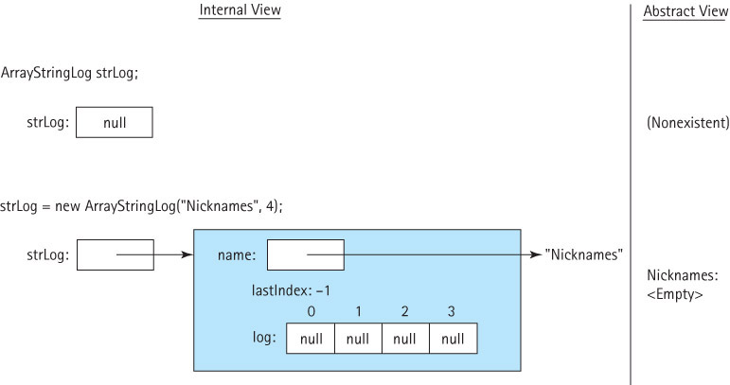
Example Use of Insert

Slide 37
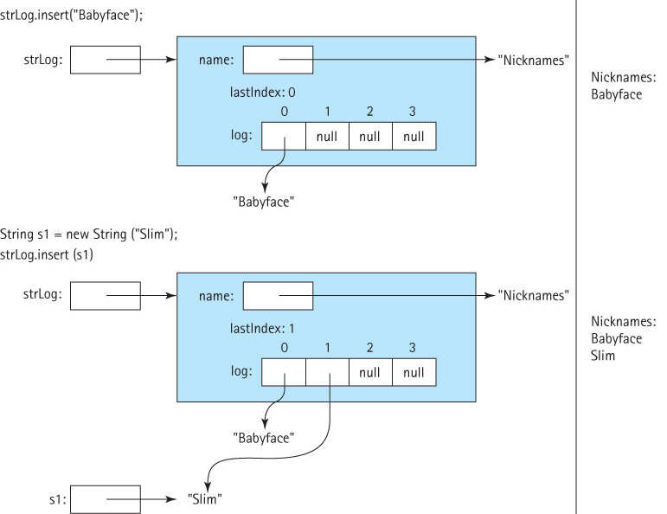
Example Use of Insert (2)

Slide 38
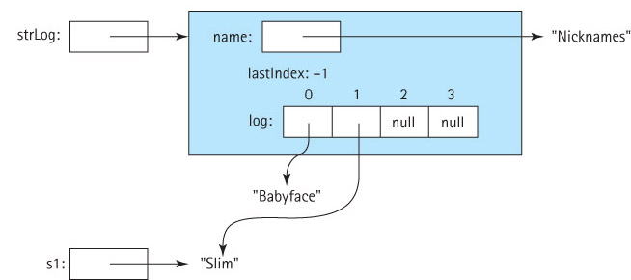
The Clear Operation
The “lazy” way: public void clear()
// makes this StringLog empty
{
lastIndex = -1;
}

Slide 39
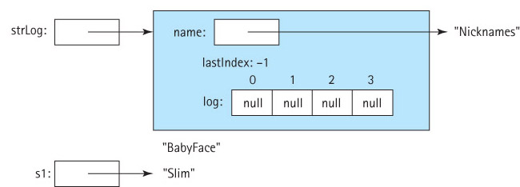
The Clear Operation
The “thorough” way: public void clear()
// makes this StringLog empty
{
for (int i=0; i<=lastIndex; i++)
log[i] = null;
lastIndex = -1;
}

Slide 40
Three Observers (Accessors)
public boolean isFull()
// Returns true if this StringLog is full, otherwise returns false.
{
if (lastIndex == (log.length - 1))
return true;
else
return false;
}
public int size()
// Returns the number of Strings in this StringLog.
{
return (lastIndex + 1);
}
public String getName()
// Returns the name of this StringLog.
{
return name;
}

Slide 41
The toString Method (Observer)
public String toString()
// Returns a nicely formatted string representing this StringLog.
{
String logString = "Log: " + name + "\n\n";
for (int i = 0; i <= lastIndex; i++)
logString = logString + (i+1) + ". " + log[i] + "\n";
return logString;
}
For example, if the StringLog is named “Three Stooges” and contains the strings “Larry”, “Moe”, and “Curly Joe”, then the result of displaying the string returned by toString would be
Log: Three Stooges
1. Larry
2. Moe
3. Curly Joe

Slide 42
Stepwise Refinement
Approach a problem in stages.
Similar steps are followed during each stage, with the only difference being the level of detail involved.
The completion of each stage brings us closer to solving our problem.

Slide 43
Stepwise Refinement (2)
There are two standard variations of stepwise refinement:
Top-down: The problem is broken into several large parts. Each part is in turn divided into sections, then the sections are subdivided, and so on.
Details are deferred as long as possible. The top-down approach is often used for the design of non-trivial methods.
Bottom-up: Details come first. They are brought together into increasingly higher-level components. A useful approach if you can identify previously created program components to reuse in creating your system.

Slide 44
Implementing the contains Method
top-down stepwise refinement phase 1
public boolean contains(String element)
{
Set variables
while (there are more values to search)
{
Check the next value
}
return (whether or not we found the element)
}
A combination of a programming language with a natural language, such as we use here, is called pseudocode and is a convenient way to express algorithms.

Slide 45
Implementing the contains Method
top-down stepwise refinement phase 1
public boolean contains(String element)
{
Set variables
while (there are more values to search)
{
Check the next value
}
return (whether or not we found the element)
}
A combination of a programming language with a natural language, such as we use here, is called pseudocode and is a convenient way to express algorithms.

Slide 46
Implementing the contains Method
top-down stepwise refinement phase 1
public boolean contains(String element)
{
Set variables
while (there are more values to search)
{
if (the next value equals element)
return true;
}
return false;
}

Slide 47
Implementing the contains Method
top-down stepwise refinement phase 2
public boolean contains(String element)
{
Set variables
while (there are more values to search)
{
if (the next value equals element)
return true;
}
return false;
}

Slide 48
Implementing the contains Method
top-down stepwise refinement phase 3
public boolean contains(String element)
{
int location = 0;
while (there are more values to search)
{
if (element.equalsIgnoreCase(log[location]))
return true;
else
location++;
}
return false;
}

Slide 49
Implementing the contains Method
top-down stepwise refinement phase 4
public boolean contains(String element)
{
int location = 0;
while (there are more values to search)
{
if (element.equalsIgnoreCase(log[location]))
return true;
else
location++;
}
return false;
}

Slide 50
Implementing the contains Method
top-down stepwise refinement phase 4
public boolean contains(String element)
{
int location = 0;
while (location <= lastIndex)
{
if (element.equalsIgnoreCase(log[location]))
return true;
else
location++;
}
return false;
}

Slide 51
Implementing the contains Method
top-down stepwise refinement phase 4
public boolean contains(String element)
{
// Returns true if element is in this StringLog
// otherwise returns false.
// Ignores case differences when doing string comparison.
int location = 0;
while (location <= lastIndex)
{
if (element.equalsIgnoreCase(log[location])) // match ??
return true; // if found, return true
else
location++; // if not, get ready to check next location
}
return false;
}

Slide 52
Implementing the contains Method
The while loop could be replaced with a for:
public boolean contains(String element)
{
// Returns true if element is in this StringLog
// otherwise returns false.
// Ignores case differences when doing string comparison.
for (int location=0; location <= lastIndex; location++)
{
if (element.equalsIgnoreCase(log[location])) // match ??
return true;
}
return false;
}

Slide 53
Next Time
We’ll pick back up with Section 2.4 and (most likely) finish Chapter 2.

